Slide 1
Project of Web Programming - I
Group - F

Slide 2
Team Member
Shahil Jha | Roll. No: 26
Sabin Ghimire | Roll. No: 22
Tulsa Khadka | Roll. No: 30
Prabhat Koirala | Roll. No: 15

Slide 3
Objectives
To create a standard project by using HTML, CSS and JavaScript.
To experience creation of web site while working in a group.
To experience the work problems faced in creating a website.

Slide 4
Things used in Project
HTML
CSS
Java Script
Photoshop CC
Sublime Text

Slide 5
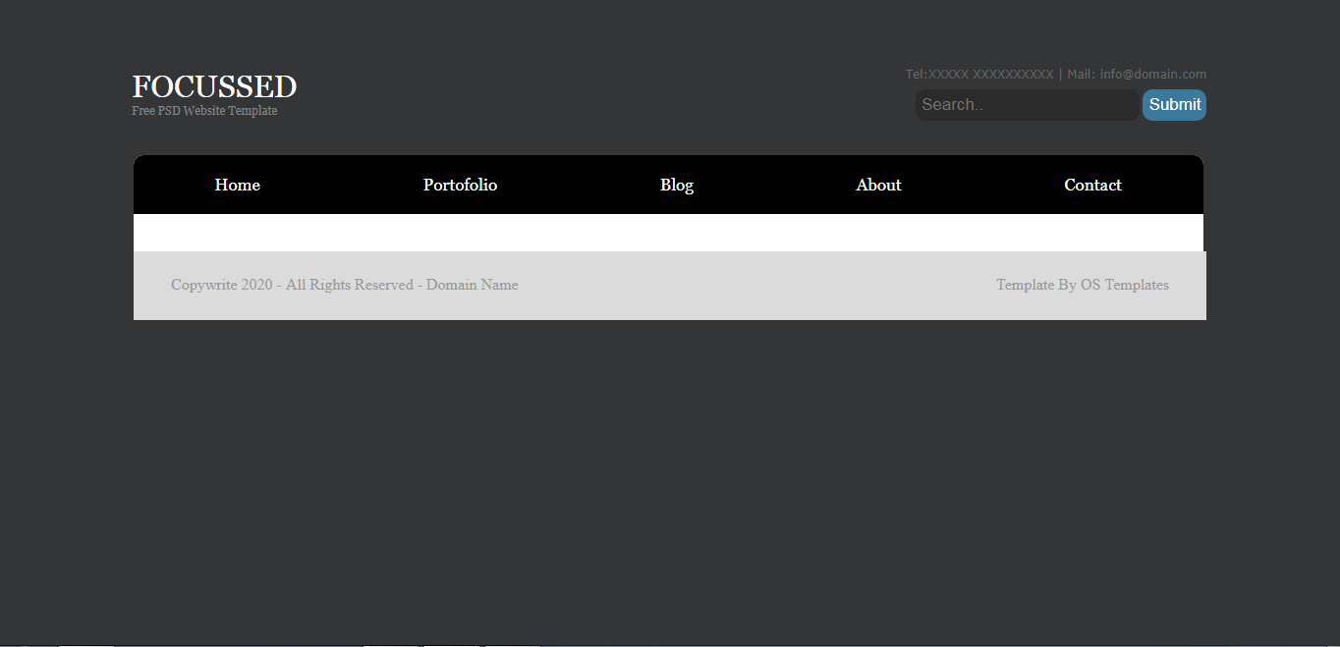
Template -pages

Slide 6
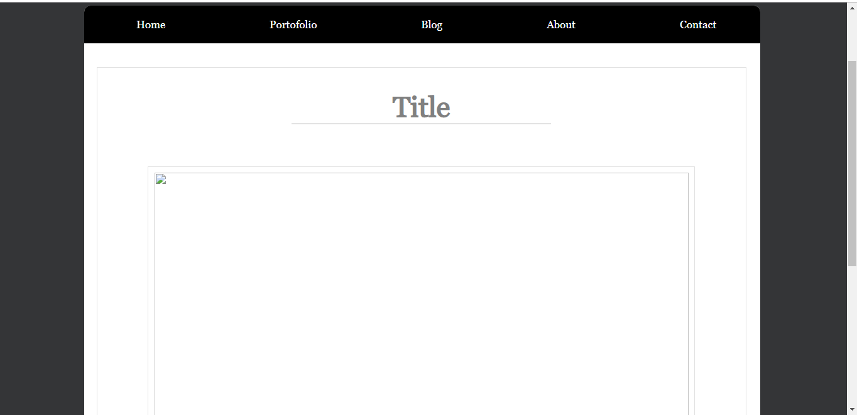
Template –blog posts

Slide 7
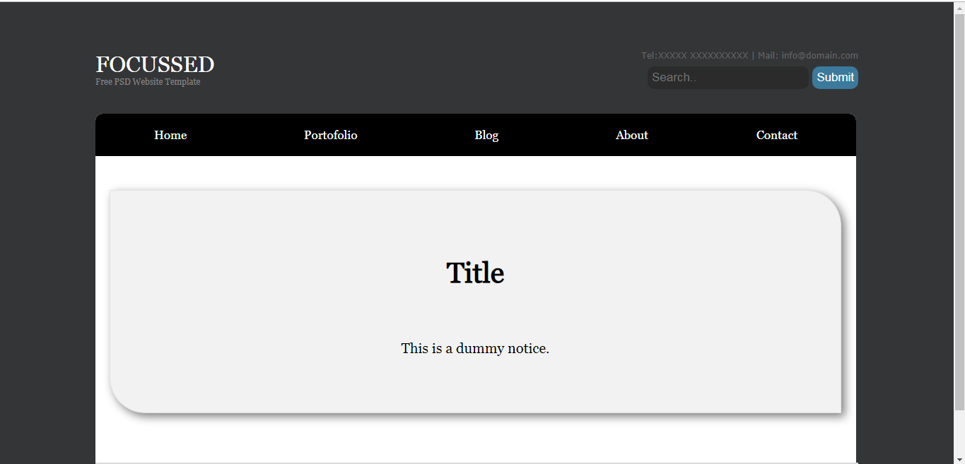
Templates -News

Slide 8
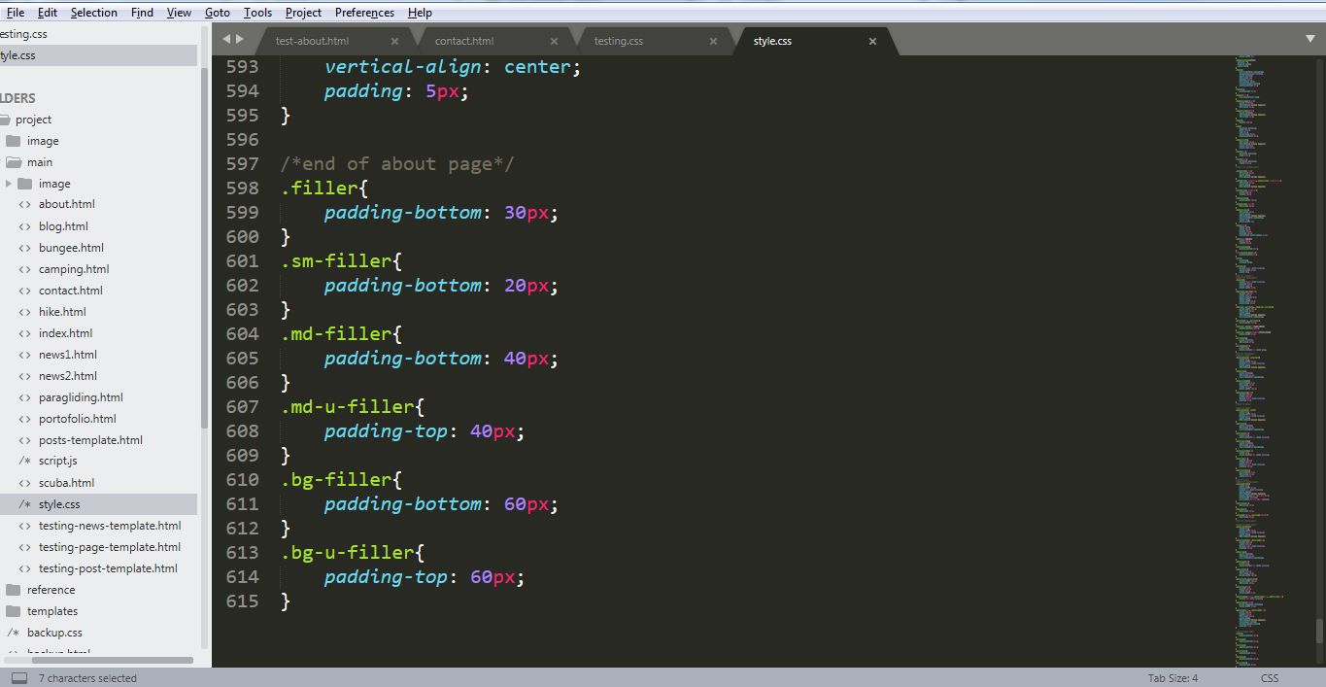
Fillers

Slide 9
Reference
Wikipedia
W3 Schools.com
CSS –tricks.com
Unsplash.com (Image only)

Slide 10
Thank You

